Slide 1
Predicting Movie Success
Mark Hubbard
Itay Segal
Nisha Choondassery
Craig Barbisan

Slide 2

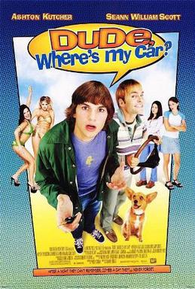
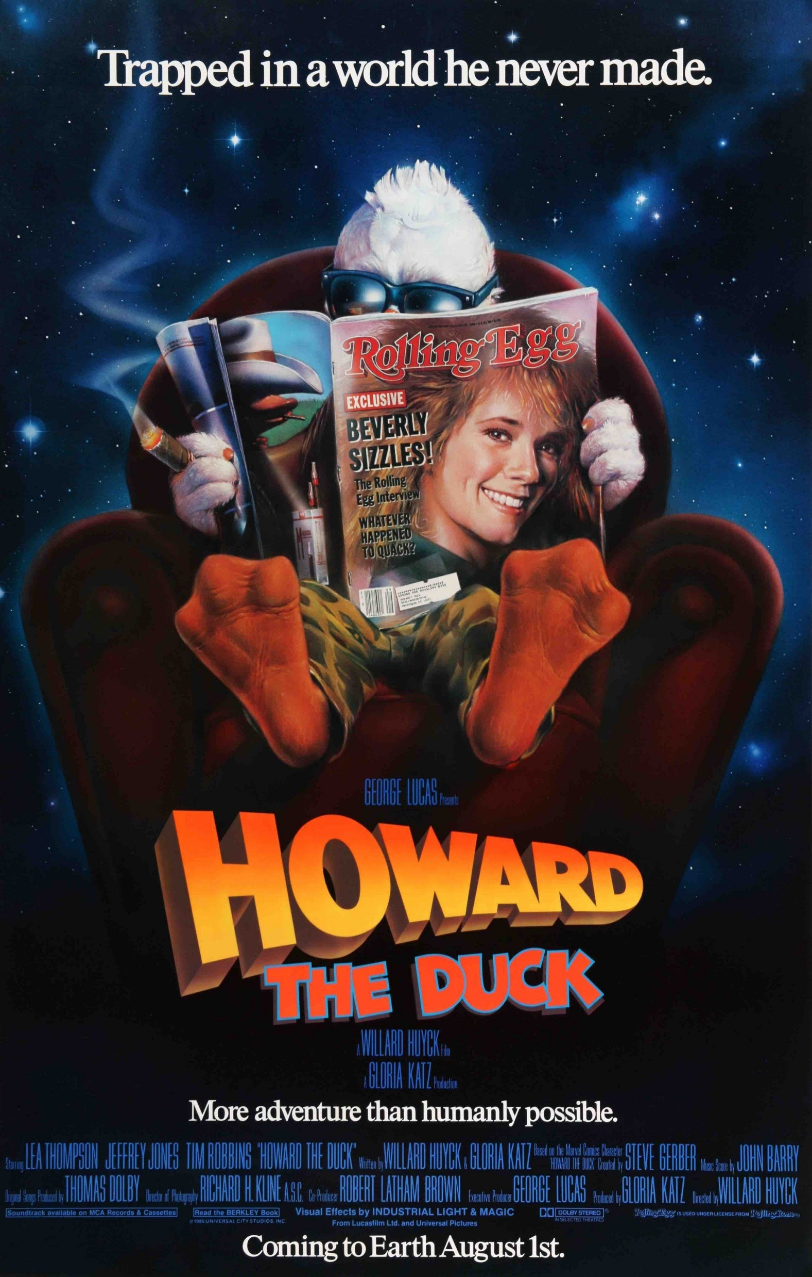
“People never forget two things, their first love and the money they wasted watching a bad movie.” - Amit Kalantri

Slide 3

Frame the Problem
Classification
Will the movie be successful?
Regression
How much revenue will the movie generate?

Slide 4
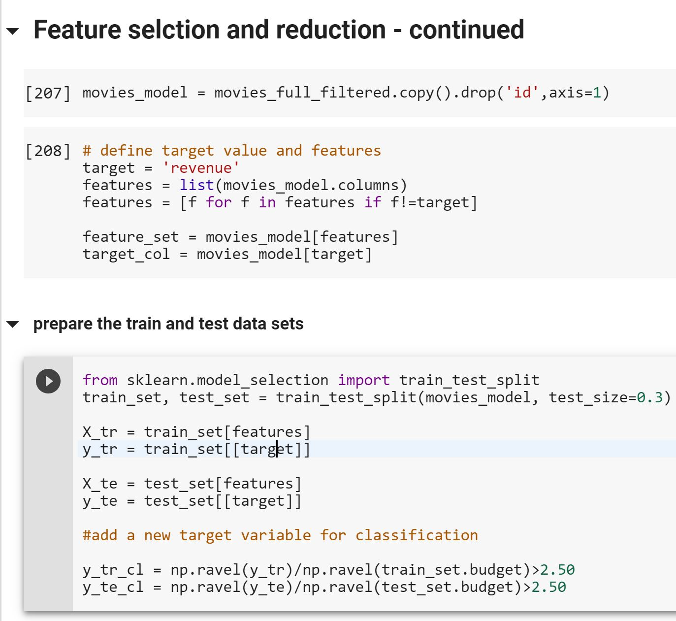
Defining “Success”
Number of awards received?
Positive reviews?
Tickets sold?
Break-even?
Profitable?
revenue = 2.5 x budget

Slide 5



Slide 6
Data Categories
Movie metadata
Credits (cast and crew)
MovieLens User Ratings
MovieLens Keywords
Movie Identifiers (IMDB, TMDB)

Slide 7
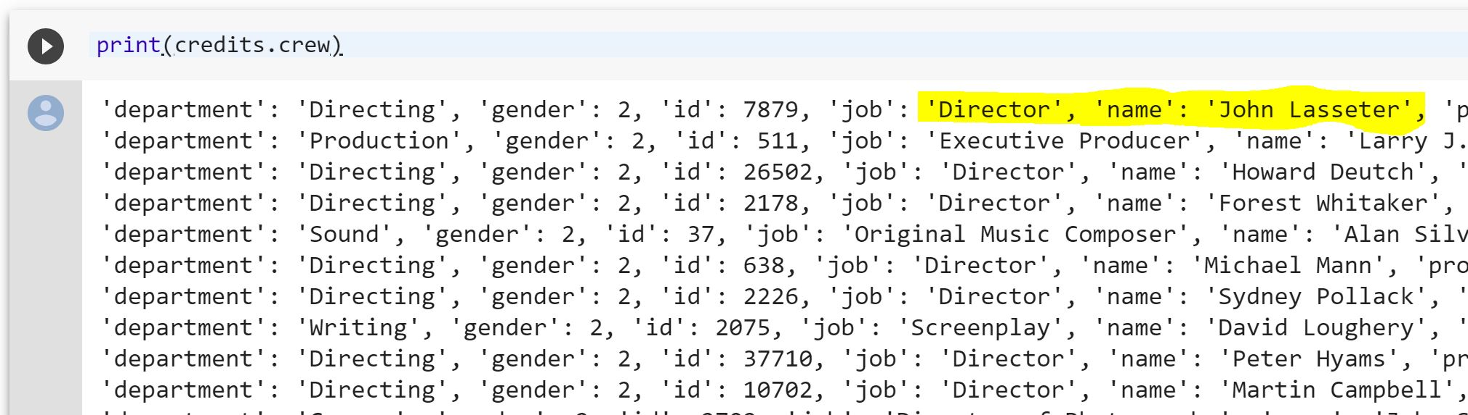
JSON Document - credits

Slide 8

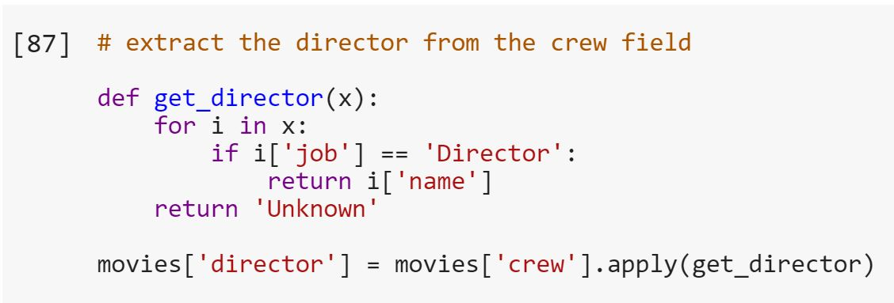
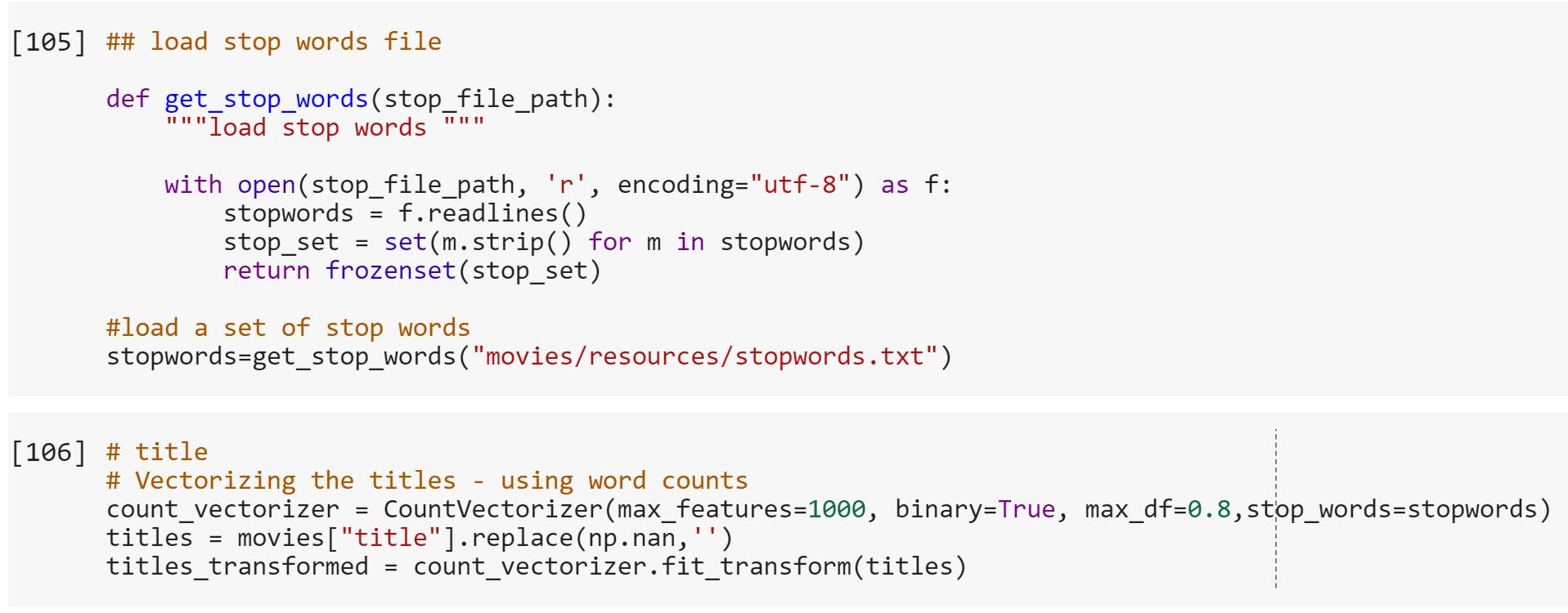
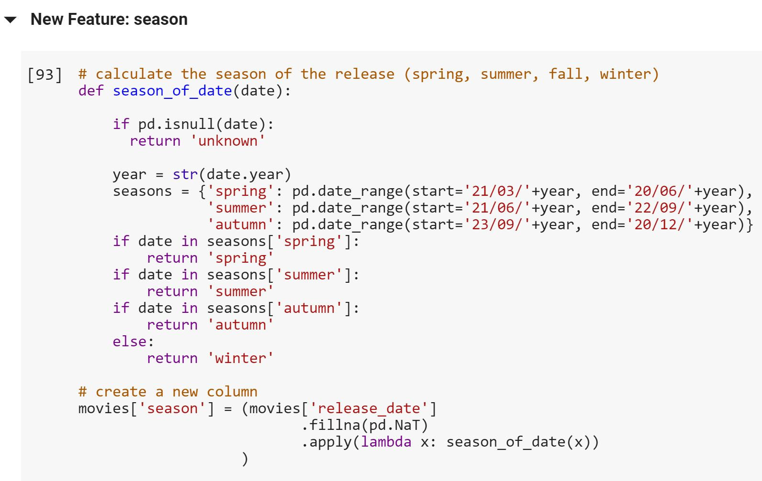
Feature Engineering

Slide 9
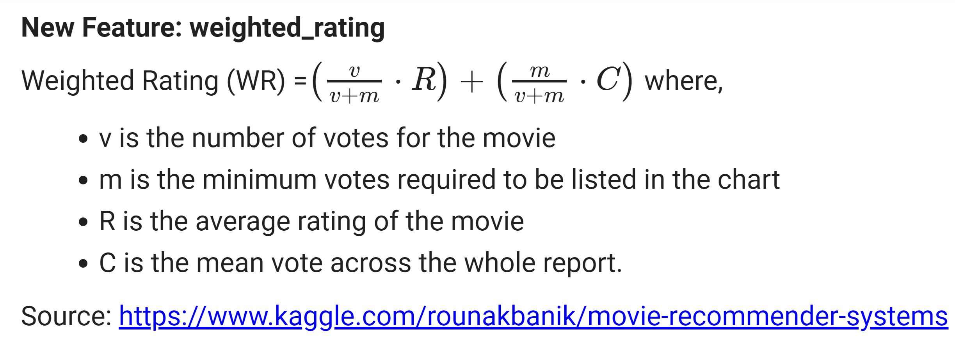
Weighted Rating

Slide 10
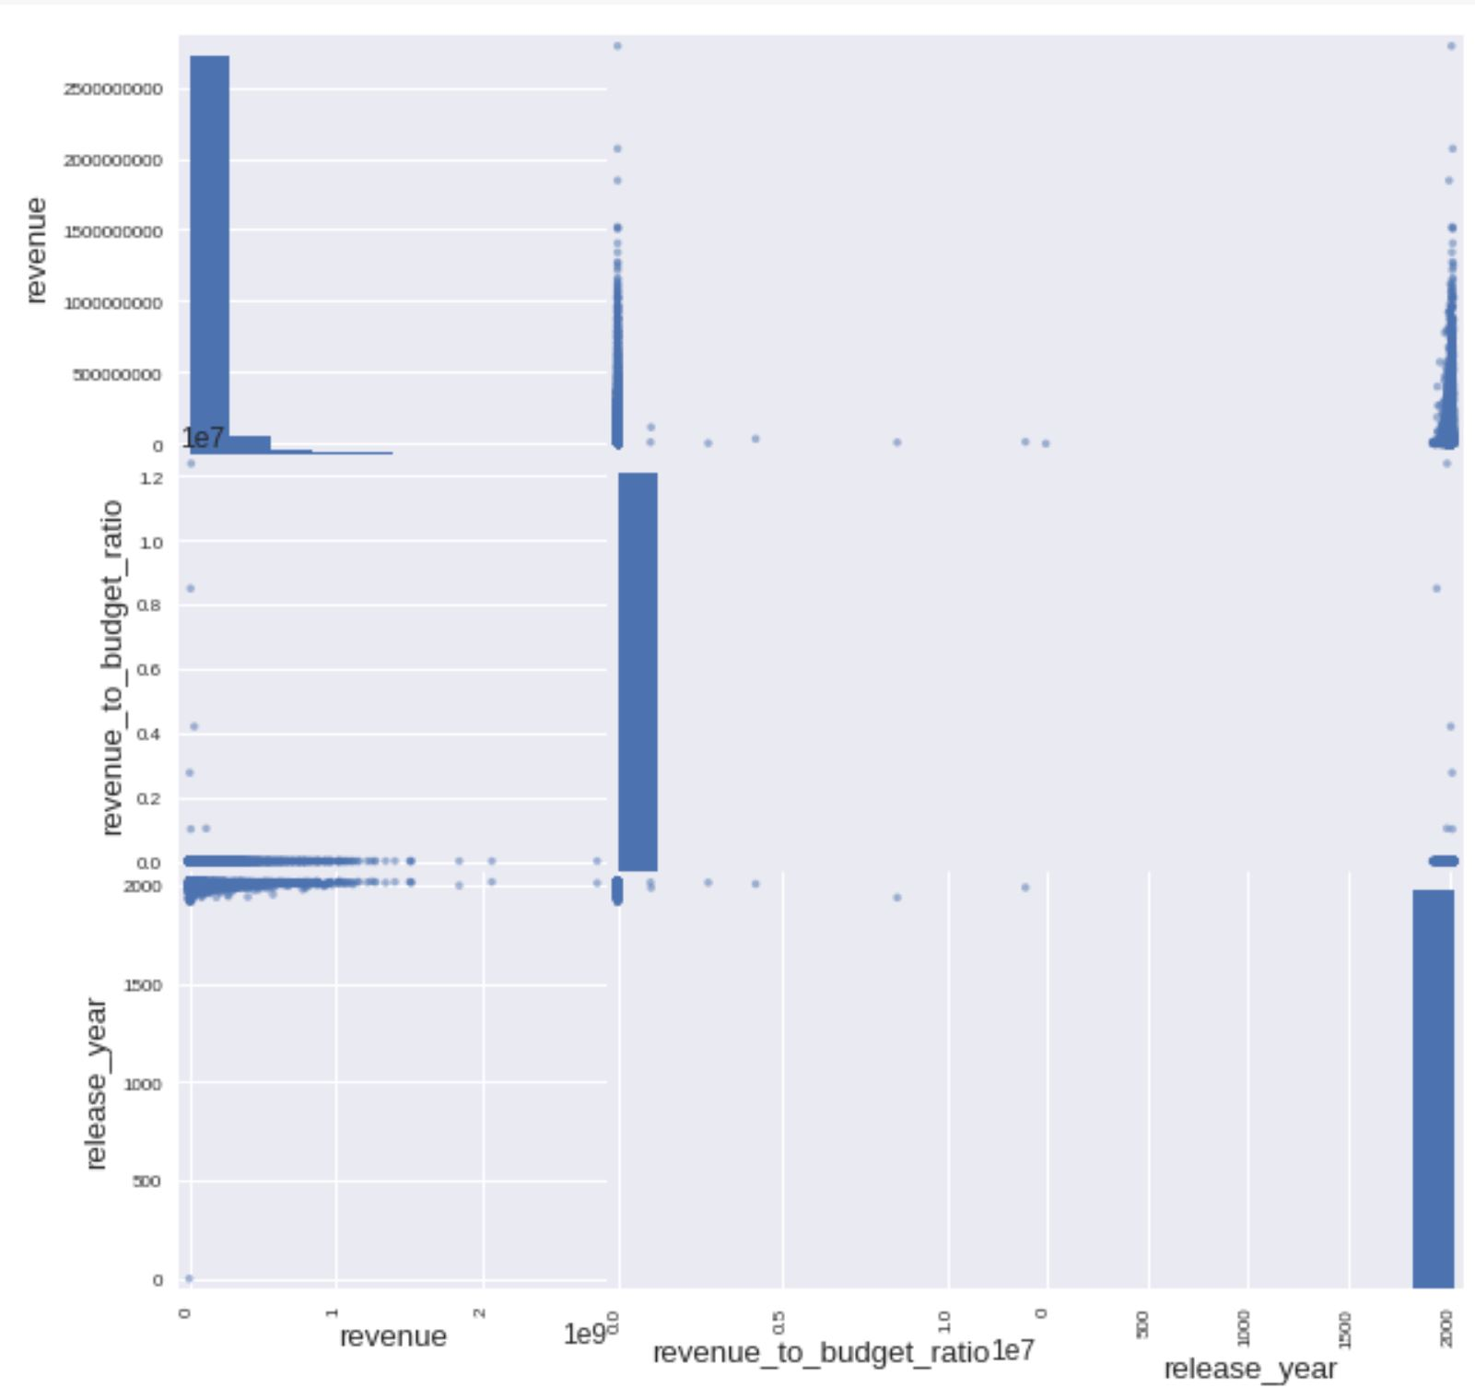
Feature Selection

Slide 11
Classification Algorithms
Algorithm | Accuracy
Logistic Regression | 0.7837
K-Nearest Neighbour | 0.7619
Decision Tree | 0.7983
Random Forest | 0.8080
AdaBoost | 0.7623
Voting Classifier | 0.7890

Slide 12
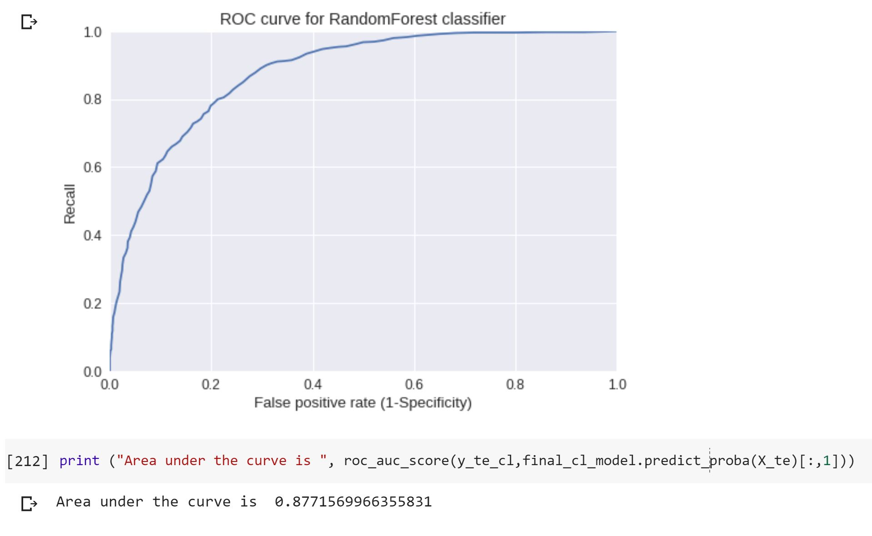
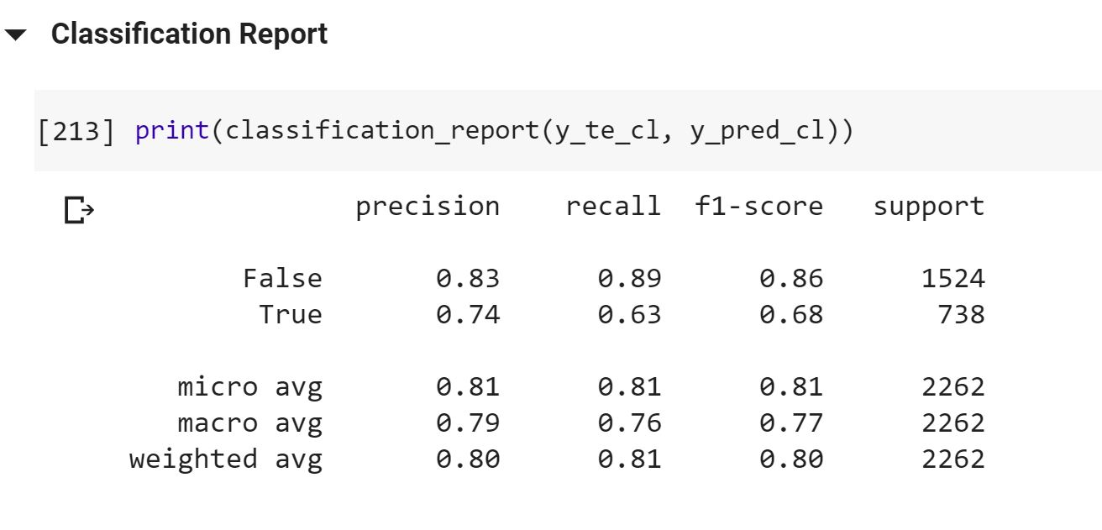
Random Forest Classification

Slide 13
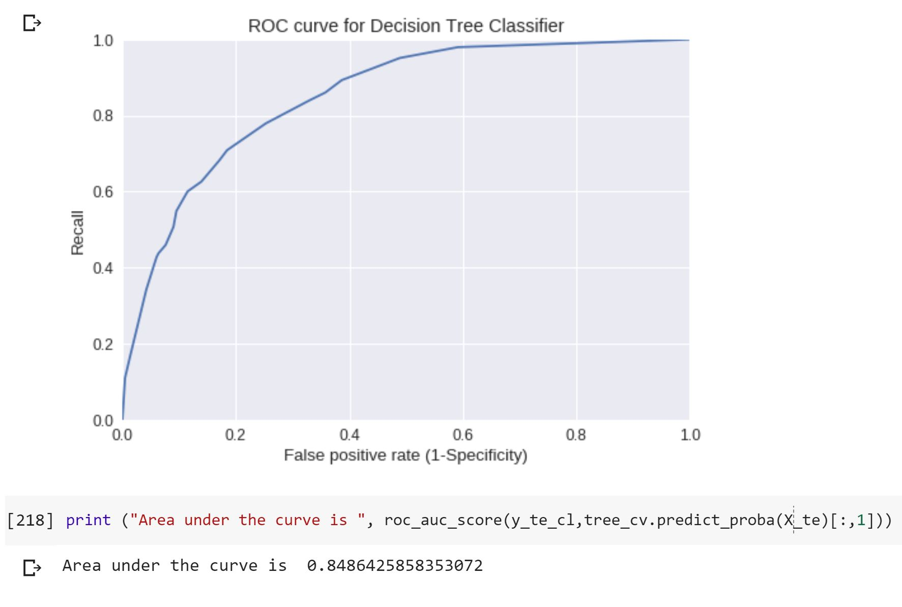
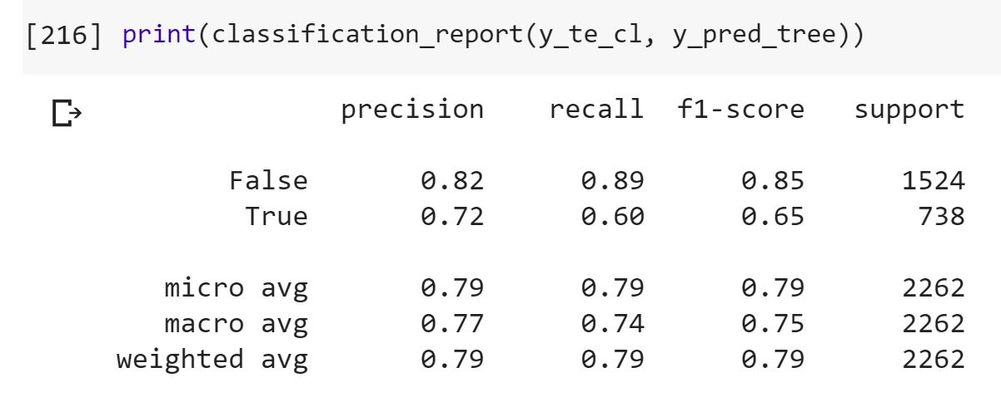
Decision Tree Classifier

Slide 14
Regression Algorithms
Algorithm | Error
Linear Regression | 75100665
Ridge Regression | 75375487
Lasso Regression | 75003445
ElasticNet | 75000055

Slide 15


Conclusions
Release year doesn’t correlate with revenue
ElasticNet provided best regression results but error was too high to be useful
Random Forest produced the best classification results
Better at predicting failure than success, which is also a useful prediction

